Slide 1
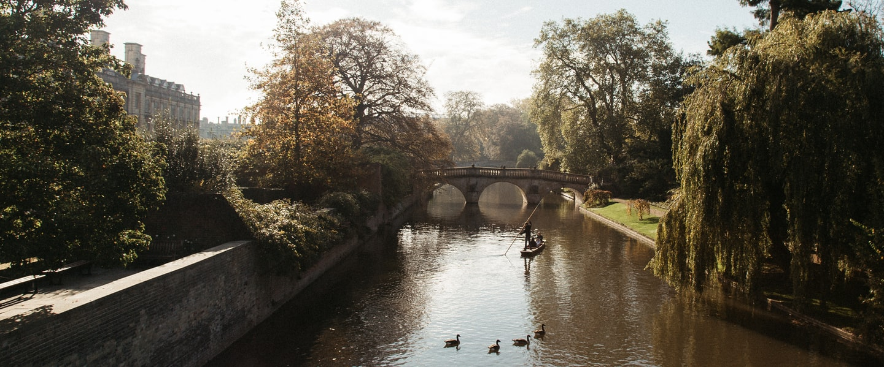
Engineering Group of The Geological Society - Annual Conference 2022
Where: Christ’s College, Cambridge, CB2 3BU
When: 31st March 2022 18:00 to 2nd April 2022 17:00
The Engineering Group of the Geological Society will host its 2020 Annual Conference between 31st March to 2nd April 2022 at Christ’s College Cambridge. The theme of this year’s conference is ‘The role of the engineering geologist in the climate change challenge’ and will bring together practitioners and academics from our industry.
Final few tickets for the conference are available!
https://billetto.co.uk/e/engineering-group-of-the-geological-society-annual-conference-2022-tickets-538170

